Slide 1

Summer internship project ppt Submitted By
Name /Semester/Course/Enrollment No. –
ANSHUL SINHA / III / BCA / A71004819044
PRATHMESH PATIL / III / BCA / A71004819033
NINAD NIRBHAVANE/ III / BCA / A71004819035
AMITY UNIVERSITY MAHARASHTRA
Amity Institute of Information Technology

Slide 2
Amity Institute of Information Technology
Certificate
Certified that the summer internship project work entitled “AI VOICE ASSISTANT” carried out by ANSHUL SINHA(A71004819044), PRATHMESH PATIL(A71004819033) and NINAD NIRBHAVANE(A71004819035) from BCA Batch are Bonafide students of Amity Institute of Information Technology and have successfully completed the Summer Internship Project of 3rd Semester in the academic year 2020.
Subject Teacher’s signature

Slide 3
PROJECT TITLE
“AI VOICE ASSISTANT”

Slide 4
INTRODUCTION
This project is based on desktop application development and provide personal assistant using voice recognition, with the help of python programming language. This program includes the functions and services of: find location, convert currencies of different countries, tell current time, can tell you the latest news, can calculate basic mathematical calculations, can answer your any general knowledge question, mail exchange, event handler, music player service, can tell you jokes, checking weather, Google searching engine, Wikipedia searching engine, direct access and search in popular e- commerce sites like amazon and flipkart, can also do direct search on entertainment platforms like Netflix, Amazon Prime Video and YouTube and initiate the result, can open almost all of the Microsoft office applications like Microsoft PowerPoint, Excel or Word and there are many other tasks which the voice assistant can do just by the voice command of the user.
Wake words rely on a special algorithm that is always listening for a particular word or phrase so that a phone, smart speaker, or something else can begin communicating with a server to do its job. Wake words need to be long enough to be distinct, easy for a human to speak, and simple for a machine to recognize. This is why we cannot change our wake word to anything we want it to be. Voice assistants don’t really “understand” what we are saying — they just listen for their wake word and then begin communicating with a server to complete a task.
As it integrates most of the desktop services for daily use, it could be useful for getting a more convenient life and it will be helpful for those people who have disabilities for manual operations.

Slide 5
Aim and Purpose
The purpose of the project is to develop a Desktop application that provides an intelligent voice assistant with sorts of different virtual functionalities. Nowadays, computers are commonly and widely used by all people. It is not a convenient way for users with completely manually input. The common way of communication used by people in daily life is through the speech. If the system can just listen to the user for the request or handle the daily affairs, then give the right response, it will be much easier for users to communicate with their system, and it will be much “Smarter” as a human assistant. This project is focusing on the voice control (recognition, generate and analyze corresponding commands, intelligent responses automatically), Google products and relevant APIs (Google map, Google weather, Google search and etc.), Wikipedia API and desktop references. As all those functionalities and services for the project have been explained, the main structure and construction of the project has been basically illustrated with its goals.

Slide 6
TOOLS USED
SOFTWARE USED: -
VISUAL STUDIO CODE (for Python Programming)
TKINTER( graphical interface used in vs code)
WINDOWS 10 HOME
HARDWARE USED: -
Intel® Core™ i5-8300H CPU @ 2.30GHz PROCESSOR
8.00 GB RAM
1 TB HDD STORAGE CAPACITY

Slide 7
MODULE DESCRIPTION
This project is all about the creation of an AI voice Assistant which is made by using Python programming language.
We have worked with python in Visual Studio Code, using the Microsoft Python extension.
We have defined various functions like- Speak Function (this function will program our voice assistant to speak something), Take Command Function (this function will allow our voice assistant to take microphone input from the user and returns a string output). Wish me Function (this function will make our voice assistant to wish us according to system time).
To make our voice assistant perform majority of different functions, we have imported a lot of modules from python which includes –
*pyttsx3
* webbrowser
*os
*Wikipedia
*datetime
*speech recognition as sr

Slide 8
*smtplib,
*random
*youtube_dl
*pyjokes
*wolframalpha
*subprocess.
The program includes the functions and services of:- find location, convert currencies of different countries, tell current time, can tell you the latest news, can calculate basic mathematical calculations, can answer your any general knowledge question, mail exchange, event handler, music player service, can tell you jokes, checking weather, Google searching engine, Wikipedia searching engine, direct access and search in popular e- commerce sites like amazon and flipkart, can also do direct search on entertainment platforms like Netflix, Amazon Prime Video and YouTube and initiate the result, can open almost all of the Microsoft office applications like Microsoft PowerPoint, Excel or Word and there are many other tasks which the voice assistant can do just by the voice command of the user.

Slide 9
The next step taken was to give the code a basic graphical interface. So, we use Tkinter/ TK interface for fulfilling the interface part.
Tkinter is the standard GUI library for Python. Python when combined with Tkinter provides a fast and easy way to create GUI applications. Tkinter provides a powerful object-oriented interface to the Tk GUI toolkit
This project is focusing on the desktop assistant over the voice control (recognition, generate and analyze corresponding commands, intelligent responses automatically), to make our interaction with the computer more easily and efficiently.

Slide 10
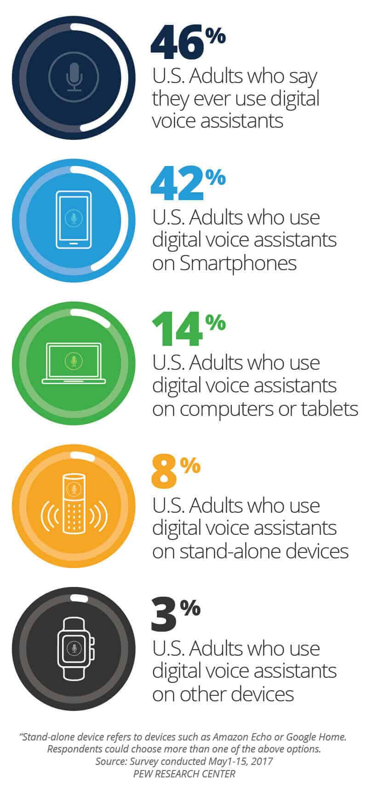
Voice Assistants on Our System
Voice assistants allow us to do a variety of tasks hands-free, which is a major reason many people like using them, especially on their phones. Apple has Siri. Google phones and most Androids have Google. Samsung has Bixby. Windows phones have Cortana. A Pew Research Center survey in May 2017 showed that nearly half of all adults in the United States use voice-controlled digital assistants on their devices.
Voice assistants can send text messages, look things up online, provide directions, open apps, and initiate or complete many other tasks.
With the addition of separate apps on the device, our voice can be a type of remote control for our lives.

Slide 11
PROPOSED SYSTEM
The proposed system will provide following features: -
1) It always keeps listing for its name and wakes up to response upon calling with the assigned functionality.
2) Performing Wikipedia search based on voice commands and giving back the computed response through a voice.
3) Searching Internet based on user’s voice input and giving back the reply through a voice with further interactive questions by machine.
4) Direct access to e-commerce sites like amazon and flipkart and can give you the products search result through user’s voice. User just have to speak the name of the item they want to buy/view and the voice assistant will give the list of that item.
5) Direct access to entertainment sites like Netflix, Amazon Prime Video and YouTube and can give you the search result of that particular show the user wants to watch.
6) Other features such as-: find location, convert currencies of different countries, can tell you the latest news, can calculate basic mathematical calculations, tell current time, can answer your any general knowledge question, mail exchange, event handler, music player service, can tell you jokes, Performing Wikipedia search, checking weather, Google searching engine, can open almost all of the Microsoft office applications like Microsoft PowerPoint, Excel or Word and there are many other tasks which the voice assistant can do just by the voice command of the user.

Slide 13
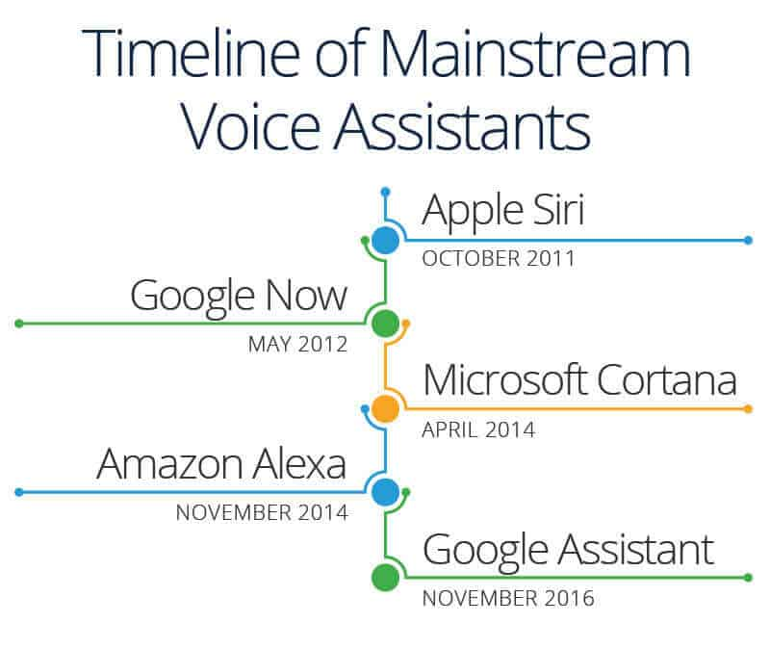
The History of Voice Assistants
Technology companies are working to create increasingly sophisticated technology that will automate more processes and tasks we do throughout the day. Even Siri, Google Assistant, and Alexa can “learn” new words and tasks.

Slide 14
Uml diagrams

Slide 15
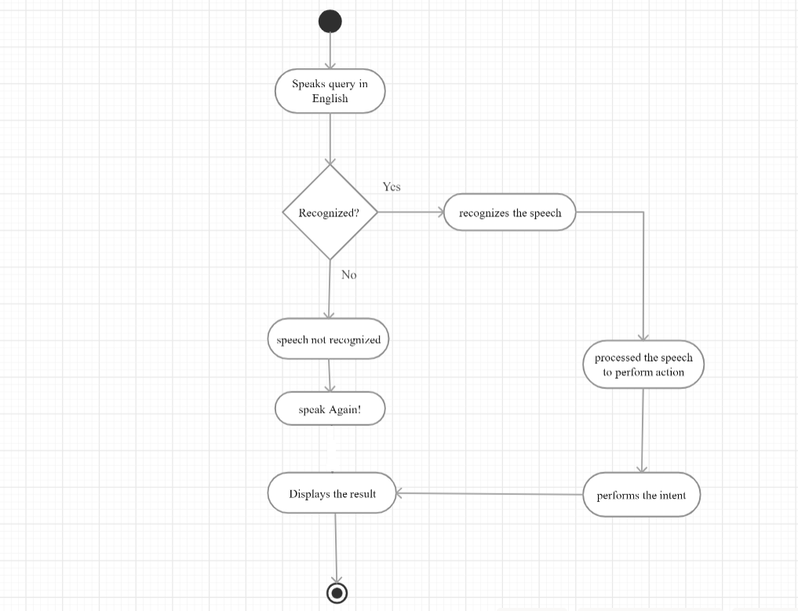
Activity Diagram

Slide 16
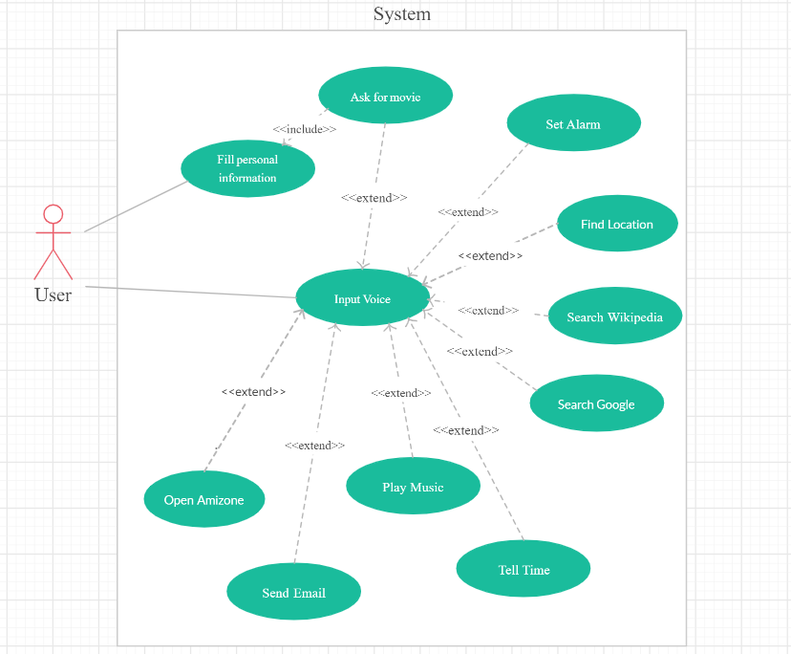
Use Case Diagram

Slide 17
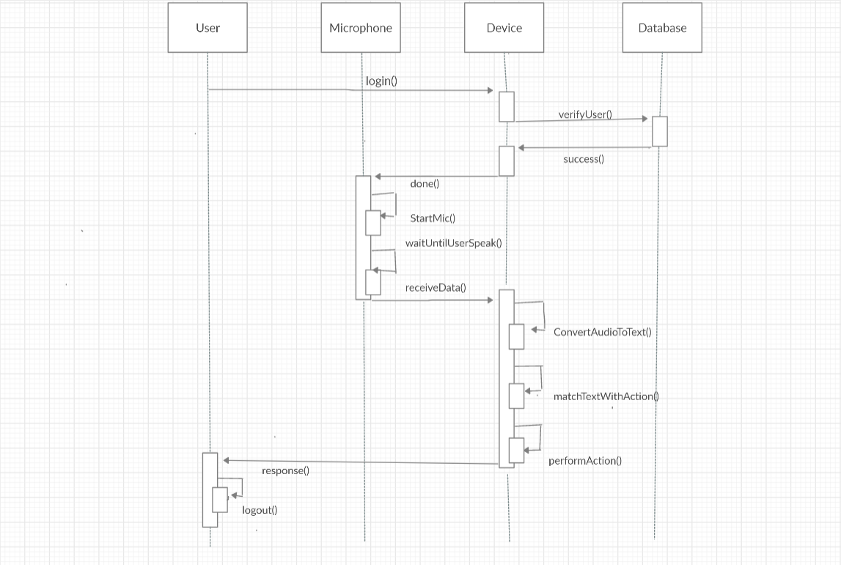
Sequence diagram

Slide 18
Screenshots of Output

Slide 19
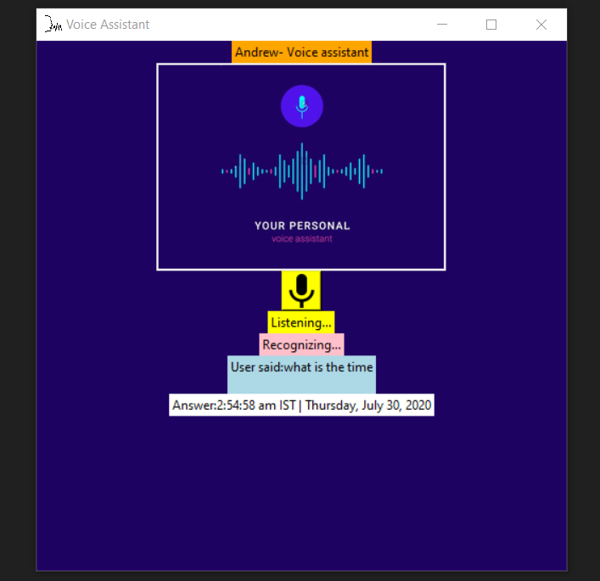

Slide 20
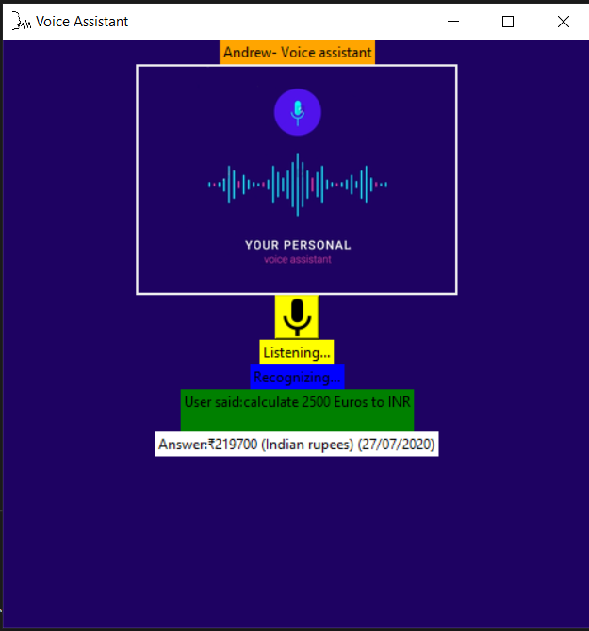

Slide 21
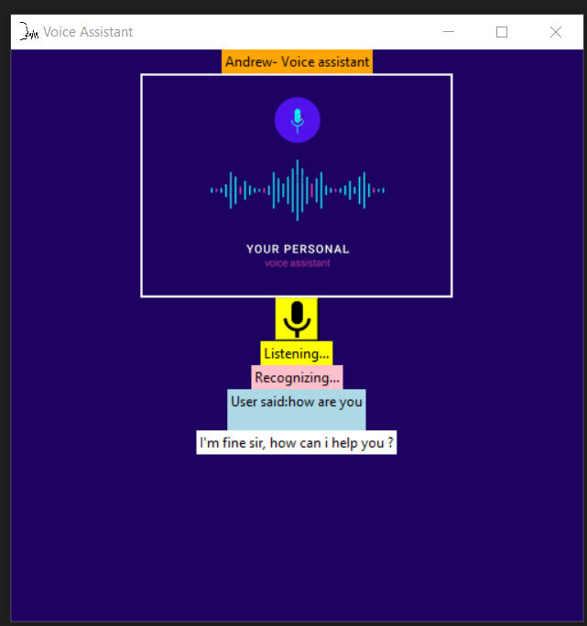

Slide 22
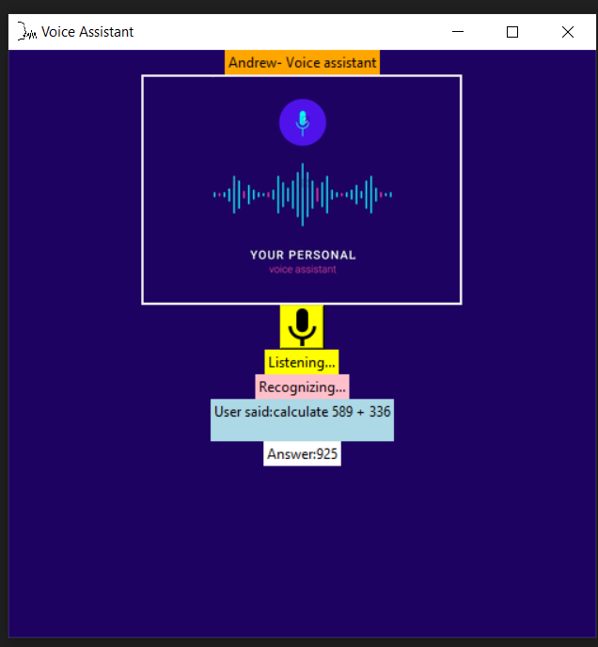

Slide 23
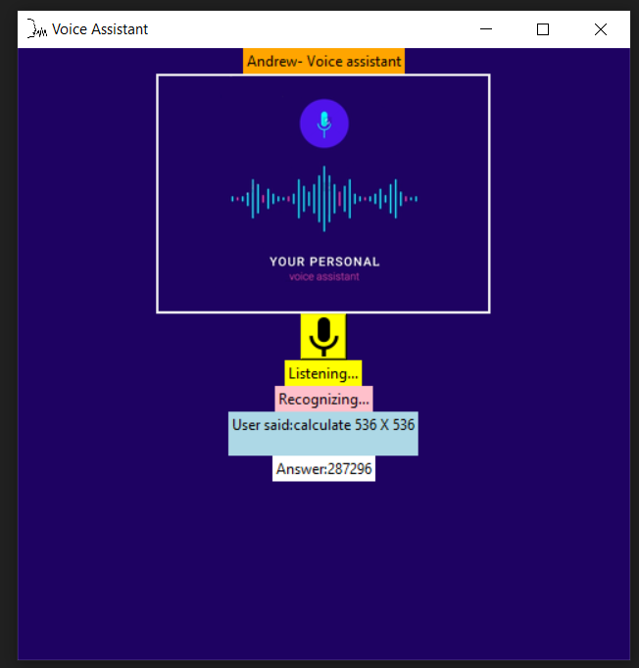

Slide 24
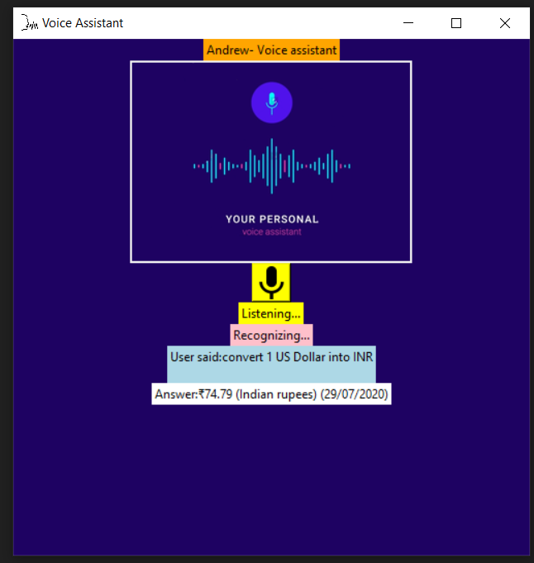

Slide 25
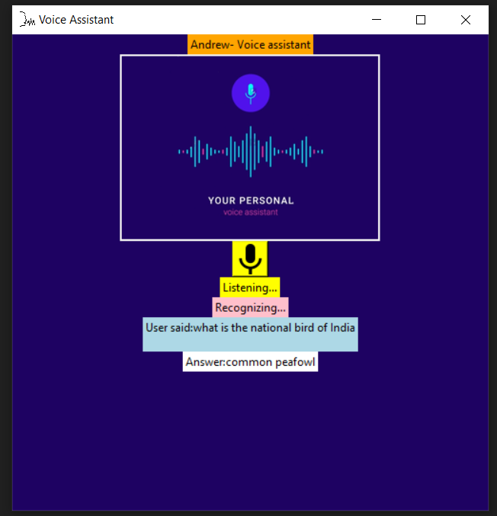

Slide 26
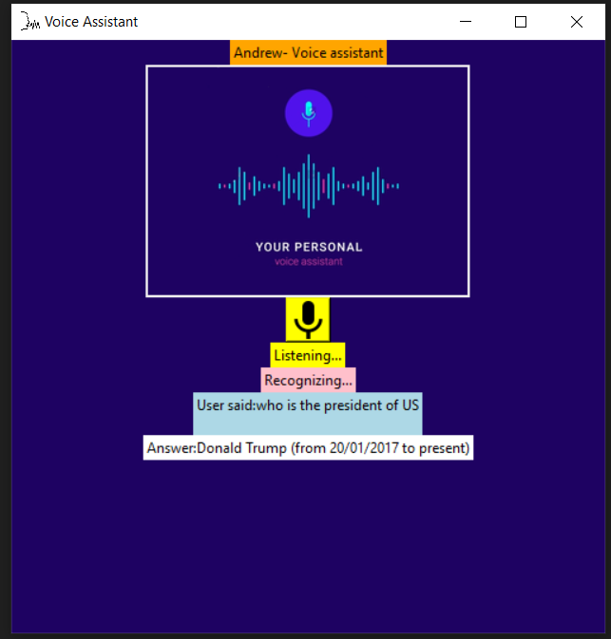

Slide 27
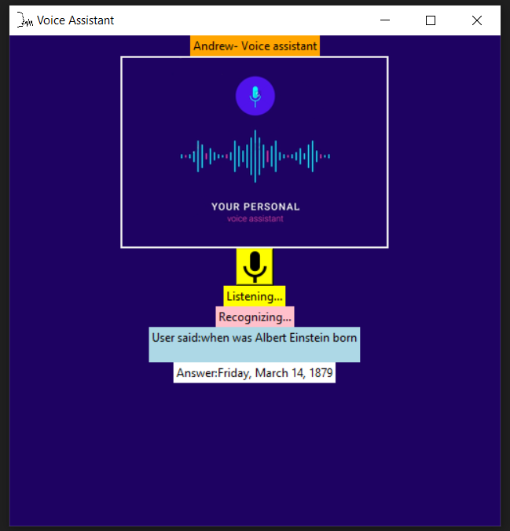

Slide 28
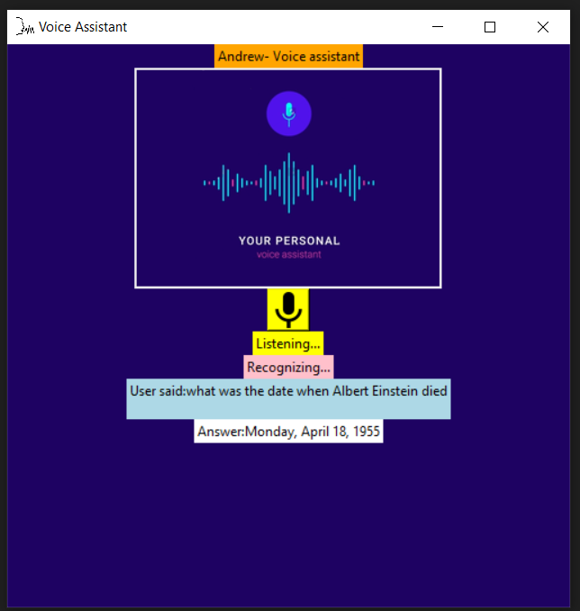

Slide 29
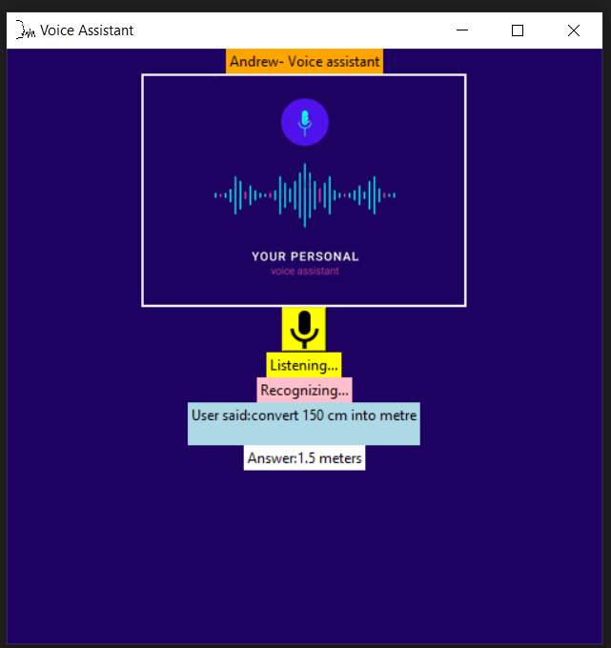

Slide 30
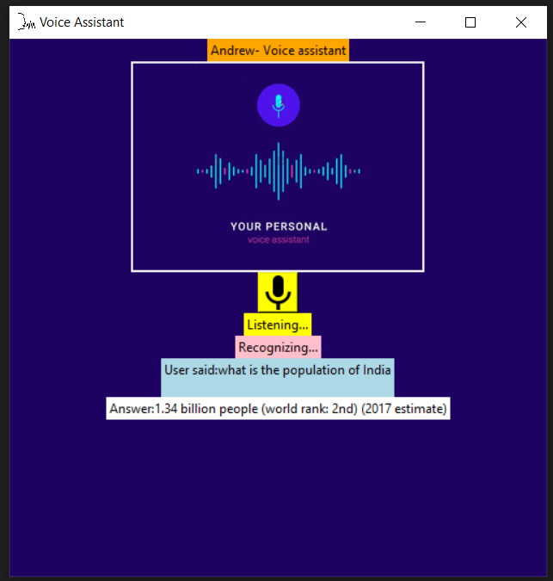

Slide 31
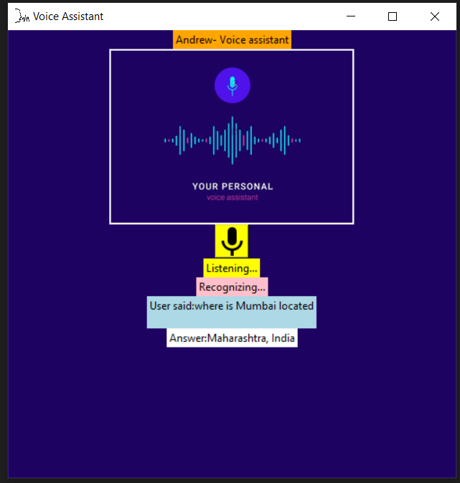

Slide 32
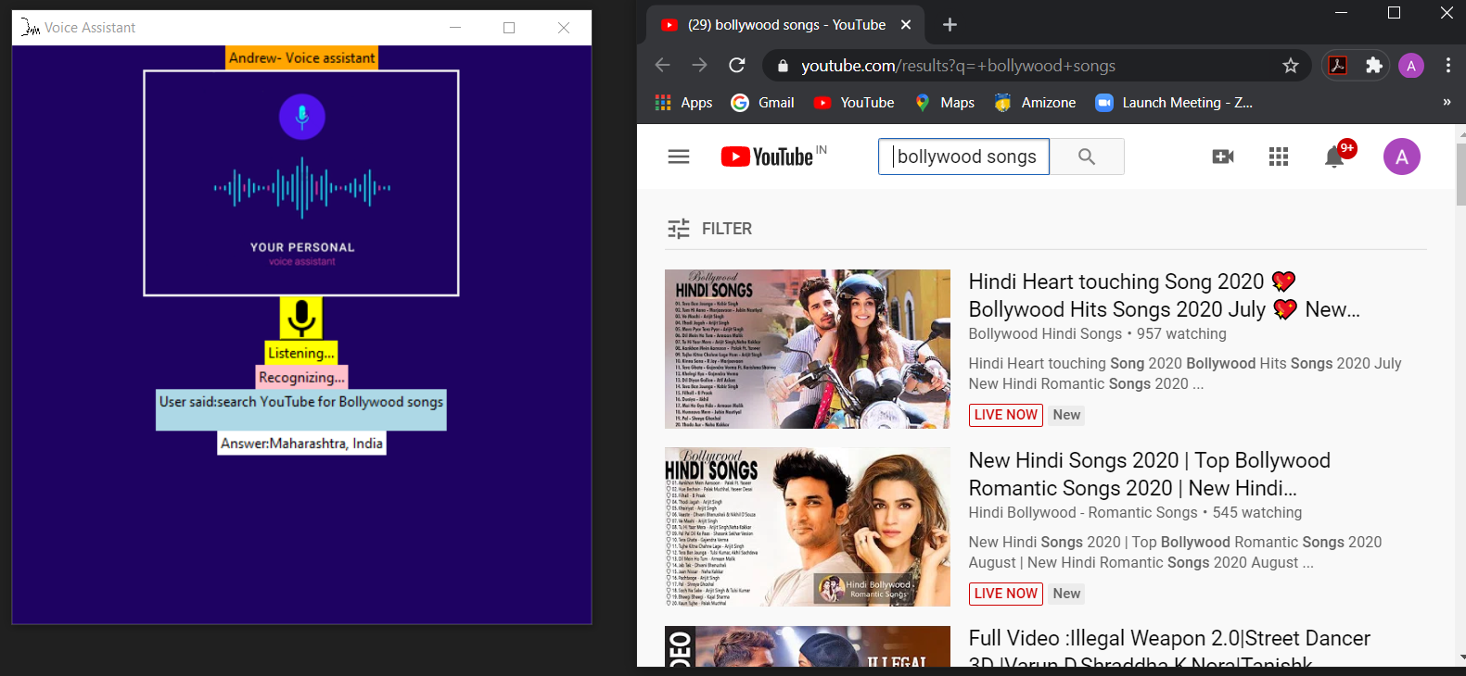

Slide 33
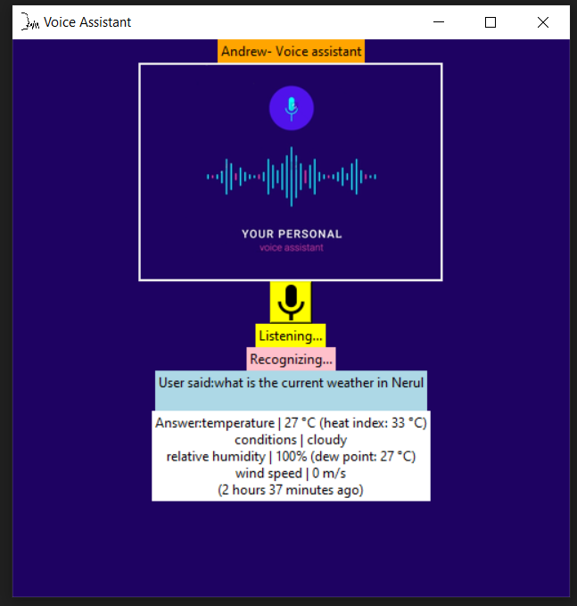

Slide 34
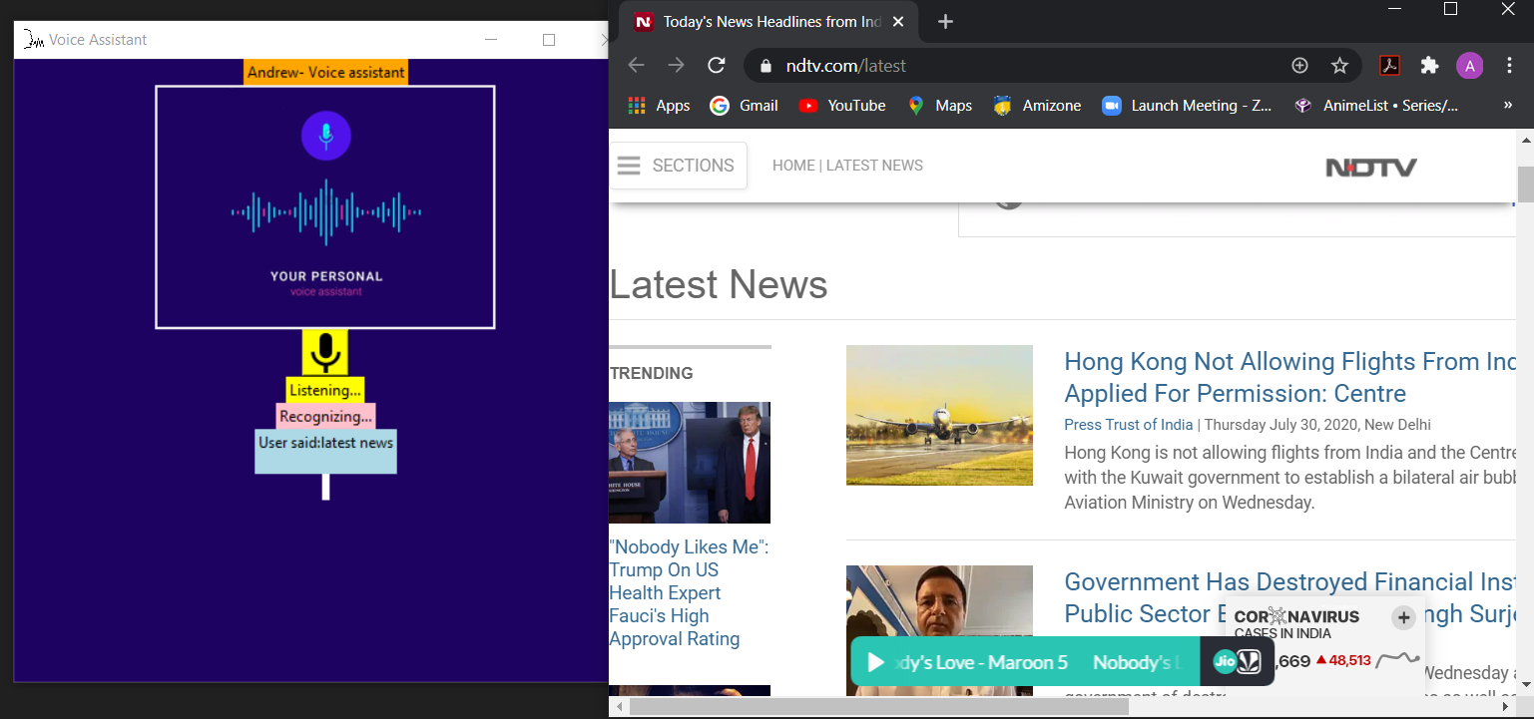

Slide 35
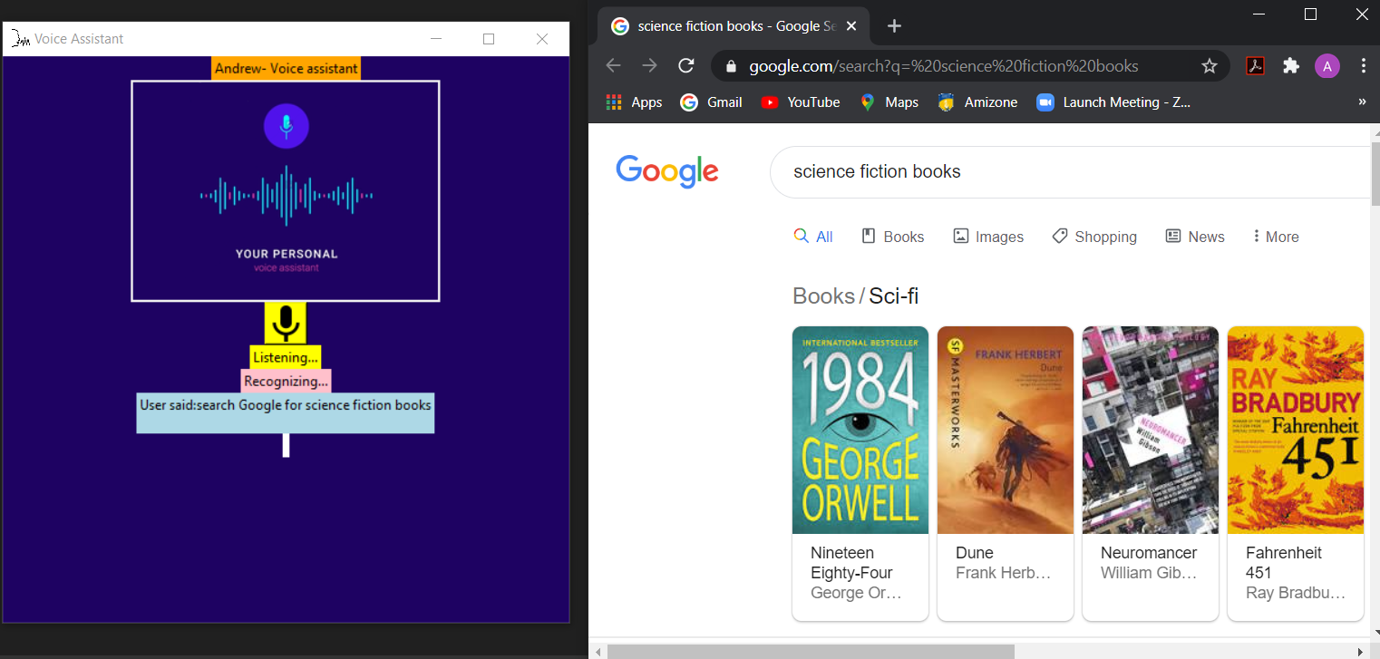

Slide 36
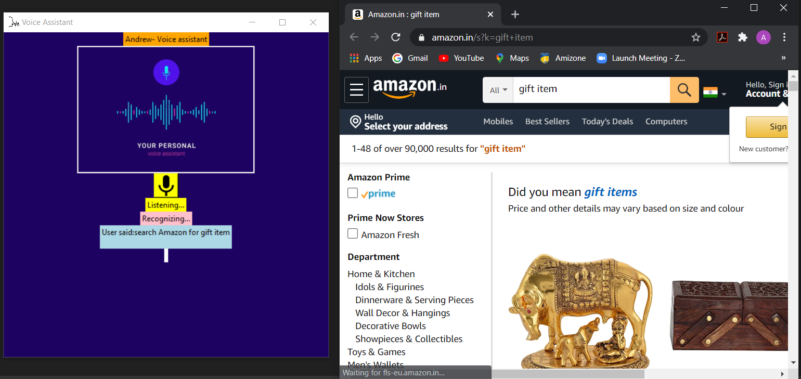

Slide 37
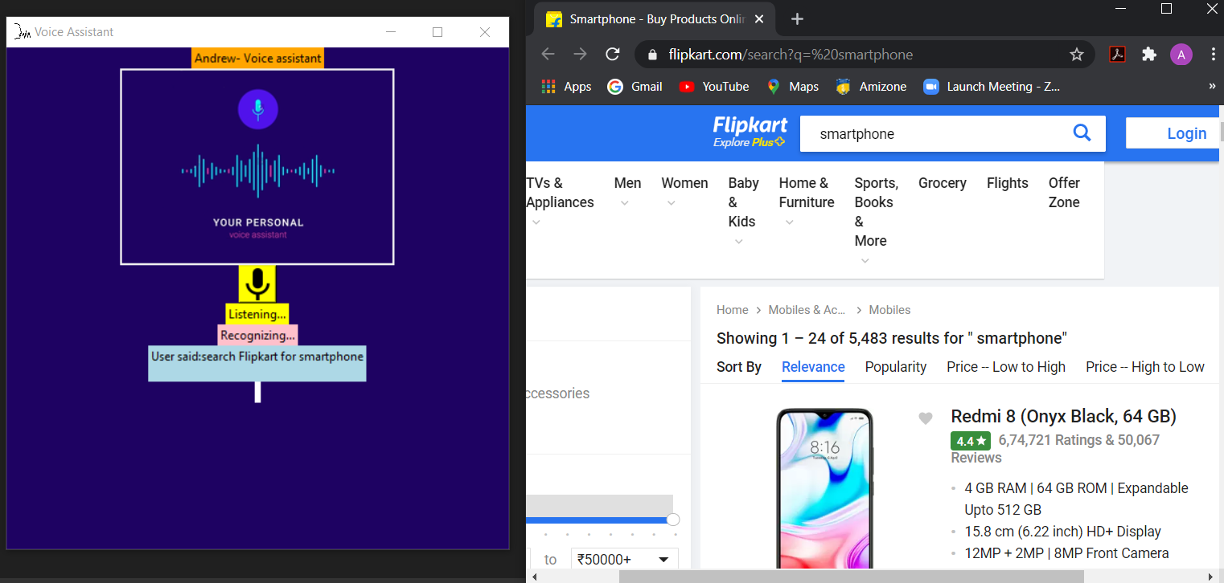

Slide 38
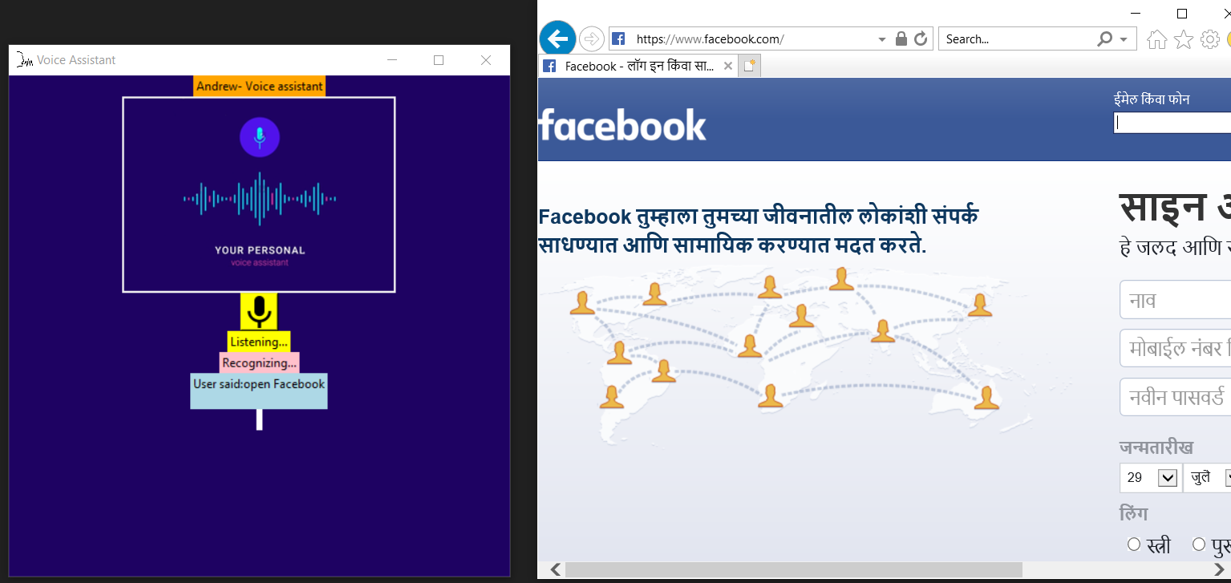

Slide 39
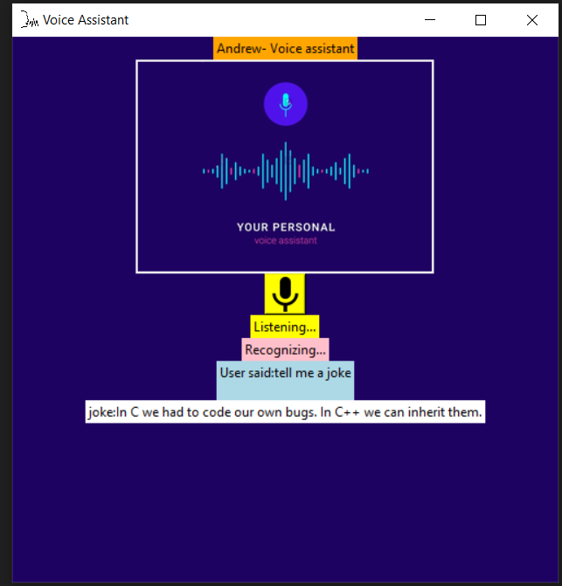

Slide 40
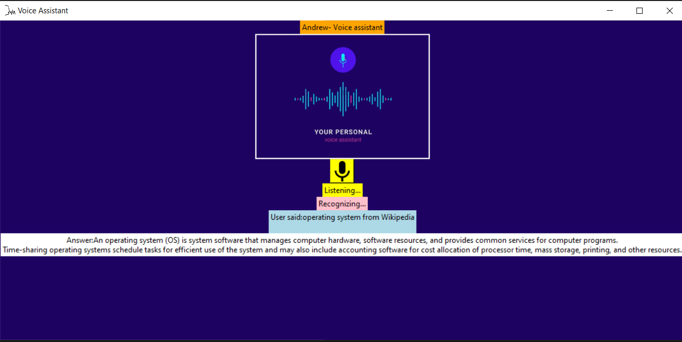

Slide 41
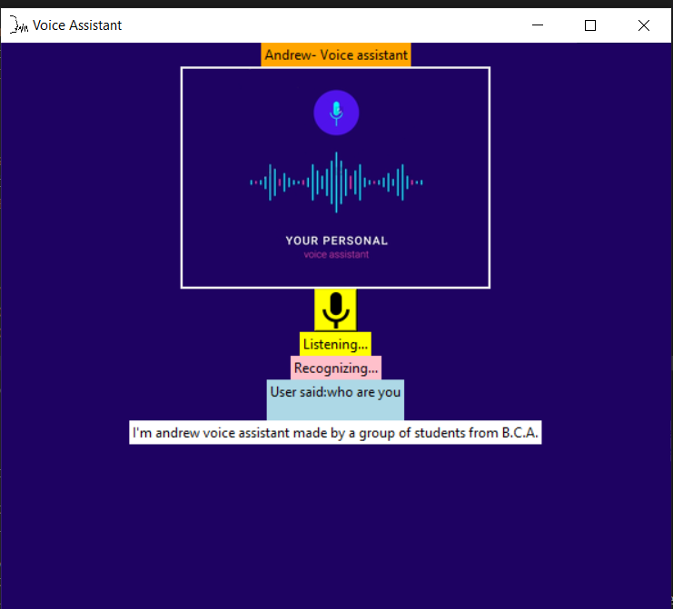

Slide 42
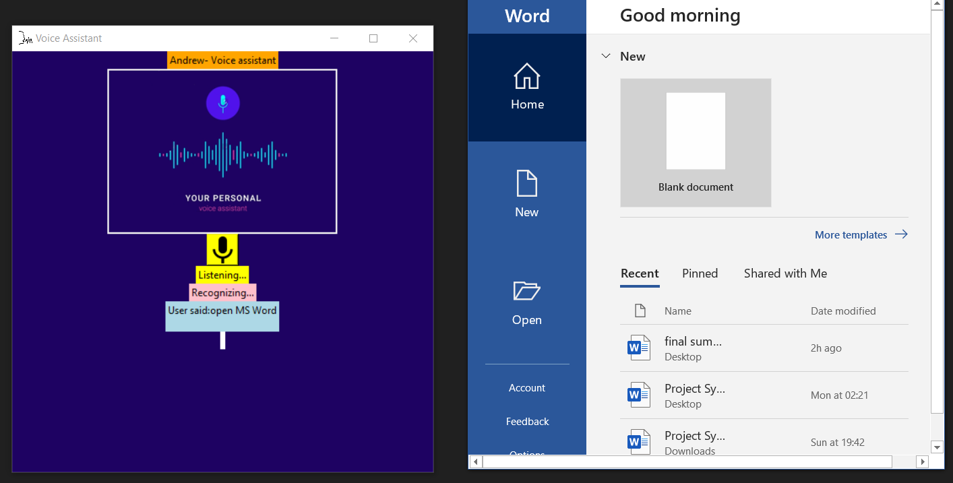

Slide 43
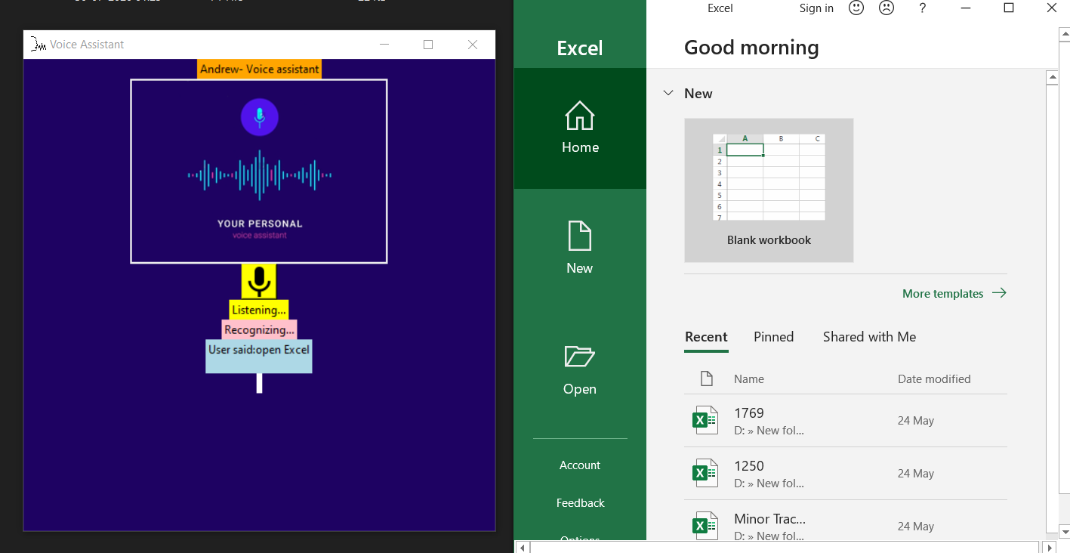

Slide 44
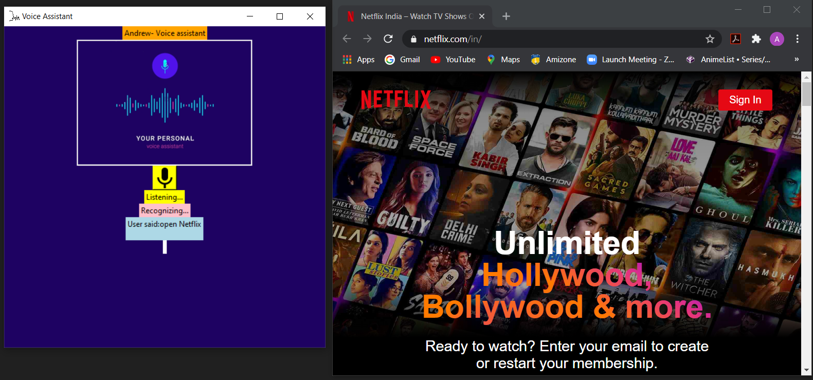

Slide 45
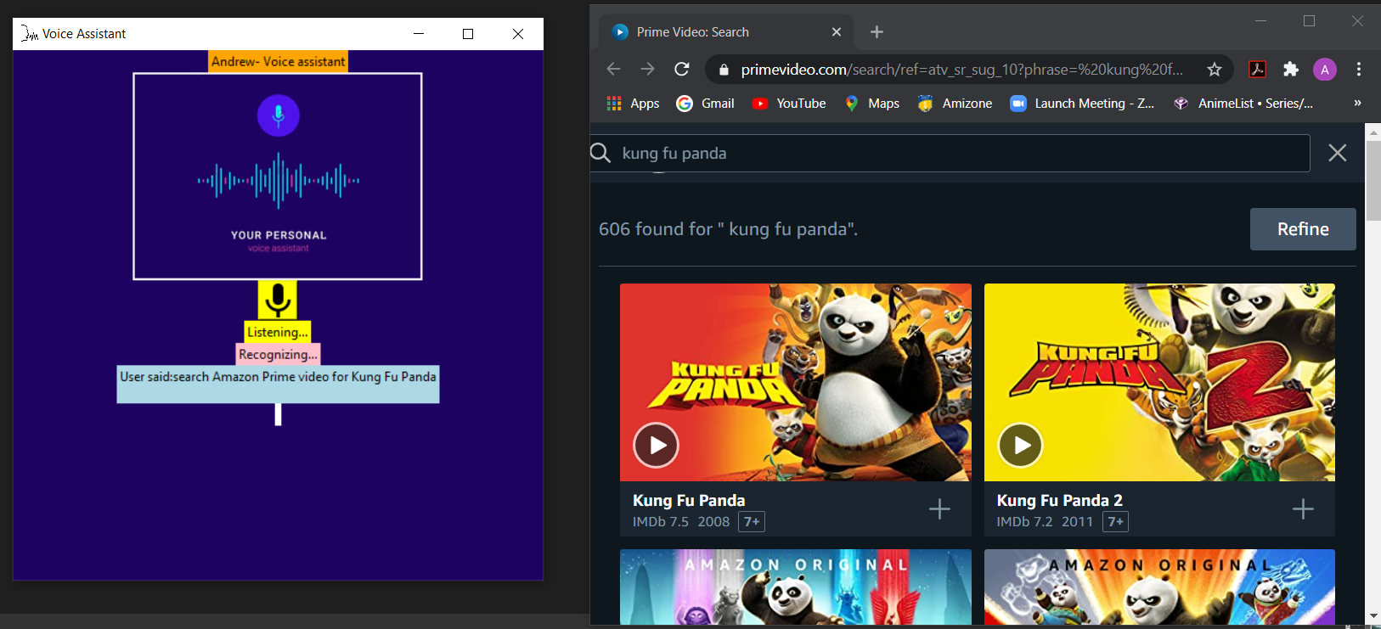

Slide 46
VALIDATION -
So, by determining the above outputs, it is shown that the voice assistant Andrew, can perform all the functions like find location, convert currencies of different countries, can tell you the latest news, can calculate basic mathematical calculations, tell current time, can answer your any general knowledge question, mail exchange, event handler, music player service, can tell you jokes, checking weather, Performing Wikipedia search, Google searching engine, can open almost all of the Microsoft office applications like Microsoft PowerPoint, Excel or Word and there are many other tasks which the voice assistant can do just by the voice command of the user.
Although the voice assistant can perform many tasks/functions, we have tried to cover as many screenshots of the output as possible.

Slide 47
RESULT & DISCUSSION
The AI voice assistant, Andrew is Designed to help Native and especially for Blind persons which works on their voice commands. Andrew has various functionalities which include find location, text message transformation, mail exchange, event handler, music player service, checking weather, Google searching engine, Wikipedia searching engine, direct access to popular e- commerce sites like amazon and flipkart, can also direct search on entertainment platforms like Netflix and YouTube and initiate , can open almost all of the Microsoft office applications like Microsoft PowerPoint, Excel or Word and there are many other tasks which the voice assistant can do just by the voice command of the user.
Hence, Andrew is language barrier independent which actively responds to user’s voice commands faster than the Online Voice Search applications.

Slide 48
Positive Effects with Voice Command-
Voice command can simplify living standards for people living with disabilities, such as reduced hearing, seeing or movability. Furthermore, voice command will help to create a more streamline living for the average person, making chores and purchases for examples much easier. The existence and availability of different safety systems on the market gives the resident the opportunity to protect and keep track of what is going on, increasing the control and safety of the person. Studies show that both voice command and music have the ability to affect human behaviour.
Negative effects with Voice Command-
Constantly talking to a voice assistant will generate vast big data possibilities, providing companies with information that might be used wrongfully by the company- contributing to an uncertainty in the privacy policies. Employing algorithms for user profiling and personalization can have a negative effect on the users, making them feel at unease and suspect or expect security threats. The possibility of numerous jobs at different locations becoming substituted by voice command assistant increases as many simple tasks, such as executing trades, easily could be handled with machine learning software’s as voice assistants and AI. The user relying on the voice command system serviceability too heavily entails a big risk seeing that the voice control is not developed to assist help in potential danger situations.

Slide 49
FUTURE SCOPE
Artificial intelligence has truly transformed the way voice assistants are used in our daily lives, and we are only beginning to understand how they will be integrated into all of our activities in the years to come.
I see a time when not only will the algorithms understand what is said, but the way it is said.
This AI Voice Assistant application can be modified in the future to determine the mood of the speaker, whether they are in distress, or how strong or weakly they may believe in the statement. It could be used to adjust the response or, in the case of security situation, whether a response is warranted. It may also lead to a means of diagnosing mental state. Ultimately, performance concepts like sarcasm would be identifiable and play a role in the response.
So basically, this AI Voice Assistant application after these modifications, thus can have a very bright future scope which can be beyond limits.

Slide 50
REFERENCES & BIBLIOGRAPHY
[1]https://www.activestate.com/blog/how-to-build-a-digital-virtual-assistant-in-python/
[2] https://docs.python.org/3/library/tkinter.html
[3] https://www.geeksforgeeks.org/python-randint-function/
[4] https://pyttsx3.readthedocs.io/en/latest/engine.html
[5] https://pypi.org/project/SpeechRecognition/
[6] https://pypi.org/project/pyjokes/
[7] “Speech recognition with flat direct models,” IEEE Journal of Selected Topics in Signal Processing, 2010.

Slide 51
The end!!!

